Slide 1
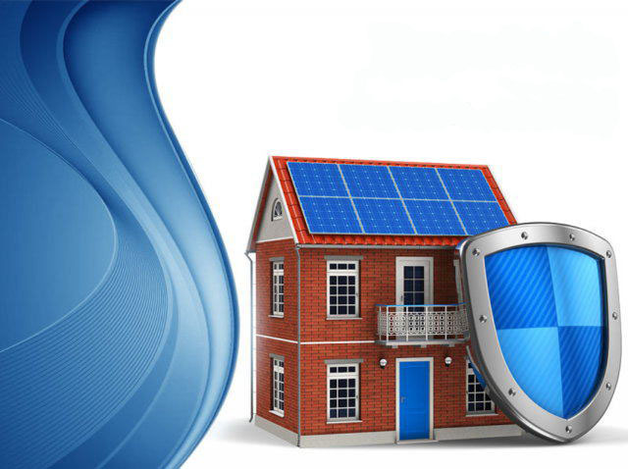
Architectural Home Plan Designing System with Knowledge Base Inspection

Slide 2

Motivation
Lack of software tools which guide to design house plans according to architectural and legal rules.
Applying all the rules manually while designing a house plan is much time consuming thus it wastes the valuable time that can be used for creative designing.

Slide 3
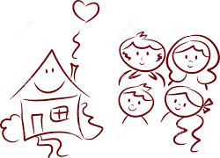
Goals
Provide an initial basic design of a house which satisfies architectural and legal rules.
Save time of architects which can be used for further beautifications and to apply creativity to design.
Provide a best home plan design which brings prosperity, peace of mind and long lives to house inmates.

Slide 4
Research Methodology
Study about architectural, legal, geometrical and scaling rules.
Study about knowledge base systems.
Define a mechanism to abstract the customer requirements.
Implement a mechanism to define a logical definition of the house which satisfies relevant rules.

Slide 5
Research Methodology (cont)
Integrate the knowledge base system with selected integrated development kit.
Integrate the selected integrated development kit with the computer aided design tool kit.
Define a mechanism to graphically visualize the house

Slide 6
Legal Rules
Septic tank
Edge of land to edge of house >10’
Wall to roof edge > 2.5’
Blind wall
Distance
should
be > 50’
Edge of land to window wall> 7.5’
Window
Bedroom – min 100 sqft
Bathroom – min 35 sqft
Living room – min 250 sqft
Dining room – min 120 sqft
Blind wall ->
No windows,
doors
well
Road
Center of road to edge of house > 12’

Slide 7
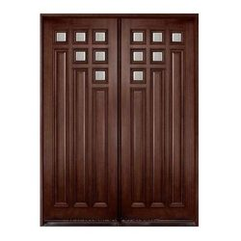

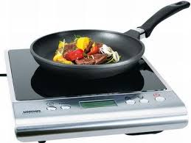
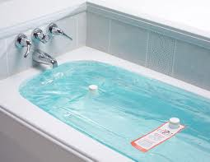



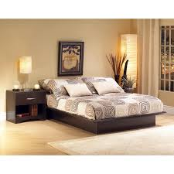
Architectural Rules
Ventilation
Main Door
North
Kitchen
Wash Room
West
East
Main Door
Study Room
South
Bed Room
Kitchen

Slide 8
Expected Scientific Output
To gain customer requirements
To design the house plan applying rules
To build a logical definition of the house
To visualize the design graphically
Define
Scientific
Methods

Slide 9
Research Questions
Import the plan of land
Configuring the directions of the land.
Define the design according to relevant measuring scale.
Represent the home design in a vertex based approach.
Generate the design of the house according to architectural, legal, geometrical and scaling rules.

Slide 10
Architects
Provide initial design of a house
Helps to make improvements in creative design
Social Benefits
Inmates
Receive a good and a reliable home design

Slide 11
Thank You

Slide 12
Some of Architectural Rules
There should be odd number of doors and even number of windows
There should be even number of windows
The main should not be directed to West
The kitchen is better to place in east-west or west-north directions
Bathrooms should not be placed in north-east direction

Slide 13
verts = (4, 2, 0), (4, -2, 0), (0,-2,0 ),(-4, -2, 0), (-4, 2, 0), (0,2,0),(4, 2, 4), (4, -2, 4), (0,-2, 4 ),(-4, -2, 4), (-4, 2, 4), (0 ,2 ,4)
faces = (0, 1, 7, 6), (1, 7, 8, 2), (2, 8, 9, 3), (3, 9, 10, 4), (10, 4, 5, 11), (11, 5, 0, 6 ), (2, 8, 11, 5)

